Slide 1

SplitIT!
Shalin Shah (Senior)
Hasnain Hossain (Senior)
Jaimin Doshi (Pre-K)

Slide 2

Overview
Goal of the Application
Audience
Competition
Design
Architecture
Pros and Cons
Remaining Work

Slide 3
Purpose:
Compete with current apps
Split the bill
Simplify process
Real-time (live)
Intuitive and Interactive UI

Slide 4
Audience:
Everyone
Restaurant goers
Individuals who live together with friends
Singles

Slide 5
Competition:
SplitWise, SpotMe, BillPin, Settle Up
Anything and everything
Social media integrated
Multiple currency support
SplitIT
No login, easy access
Synchronized
Specifically designed for restaurants/bars
Keep track of transactions

Slide 6
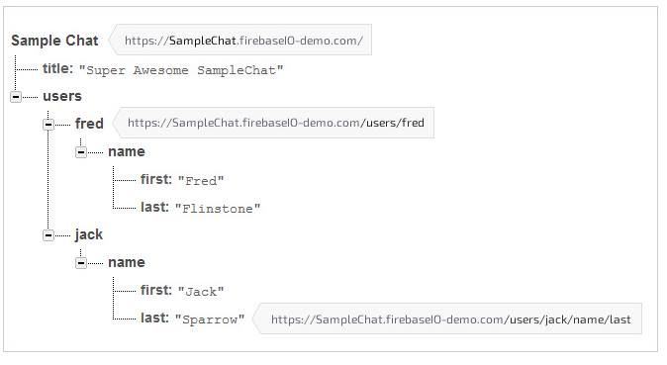
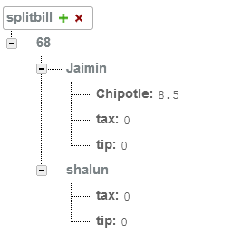
Architecture
Firebase
Real time database
Simplified design structure

Slide 7
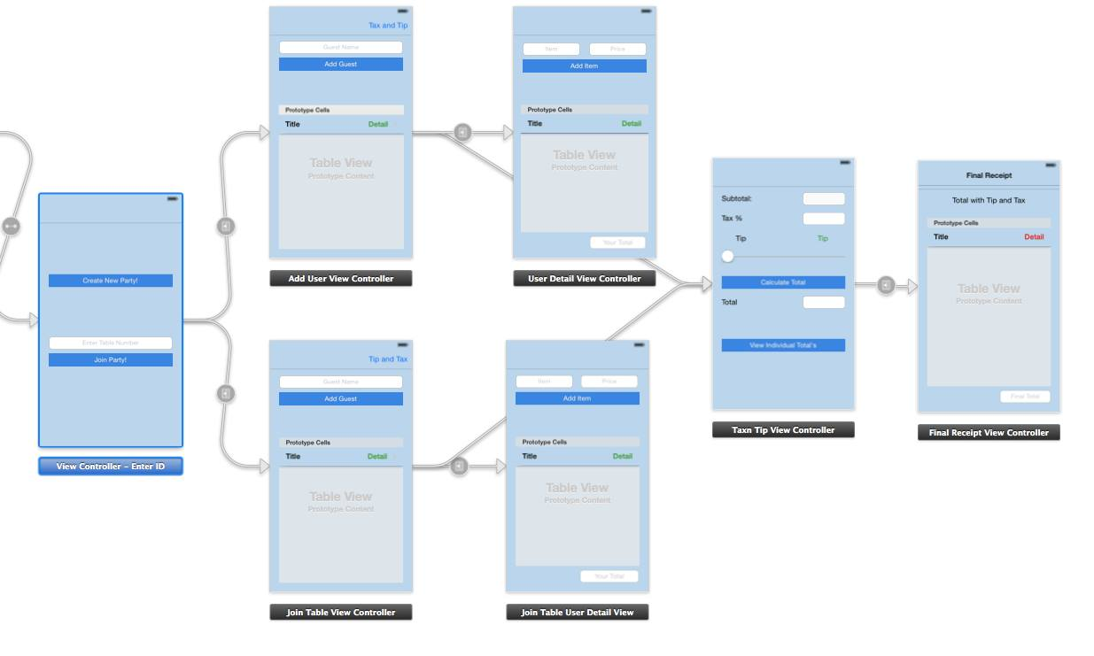
Design:

Slide 8
Pros/Cons
Pros
Sound idea
Evaluated all options before implementation
Cons
Compressively design the database structure
Code documentation
Better understanding of Objective-C *biggest challenge
Launch and deployment
More test case
Upgrade server plan

Slide 9
Demo – Q&A

